Slide 1
Types of Communication: Formal, Informal
Formal: Official
Letters, email, fax.
Written form or oral
Principal to HoDs to teachers to students.
Usually in written format.
Informal
Information exchanged about the organisation between friends colleagues in the corridors, canteen, etc.
Unofficial.
Oral in nature

Slide 2
Formal communication
Formal communication refers to the flow of official information through proper, predefined channels and routes.
Formal communication follows a hierarchical structure and chain of command
Informal communication
Informal communication is casual communication between coworkers in the workplace.
Unofficial in nature
Based in the informal, social relationships that are formed in the workplace.
95% C is informal in organisations.

Slide 3
Formal communication
Upward
Downward
Lateral
Diagonal
Informal
1. Single strand
2. Gossip
3. Probability
Cluster

Slide 4


Slide 5
Formal communication 4 ways
Downward
Upward
Horizontal
Diagonal

Slide 6
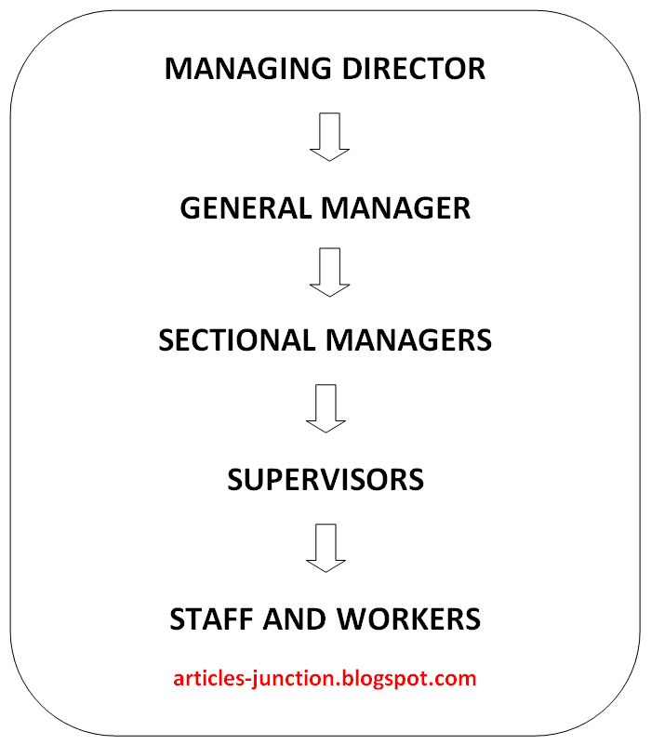
Downward communication

Slide 7
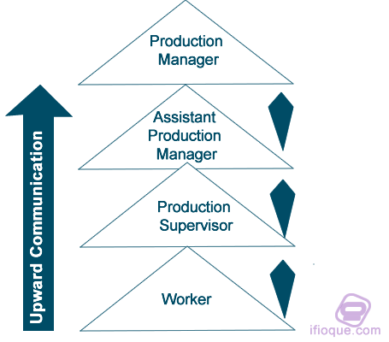
Upward communication

Slide 8
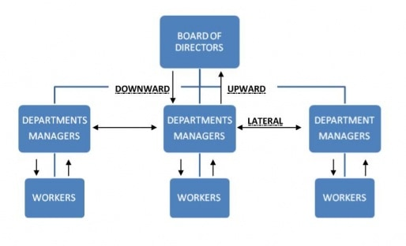
Lateral communication

Slide 9
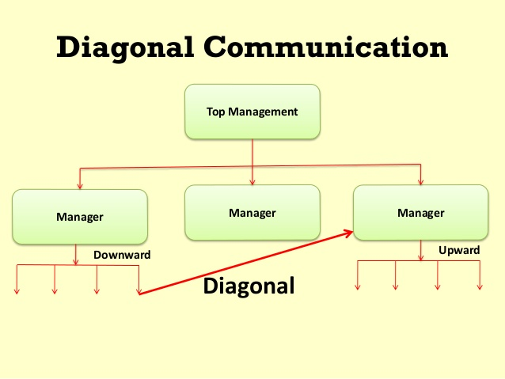

Slide 10
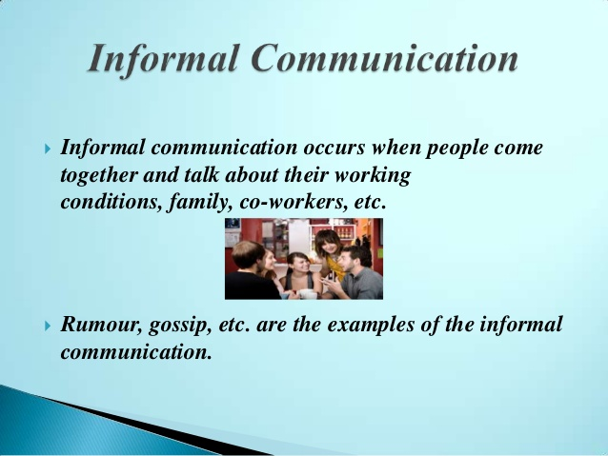

Slide 11
